Slide 1
Meiosis and Sexual Life Cycles
Chapter 13

Slide 2
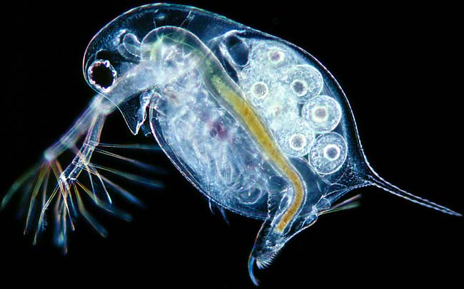
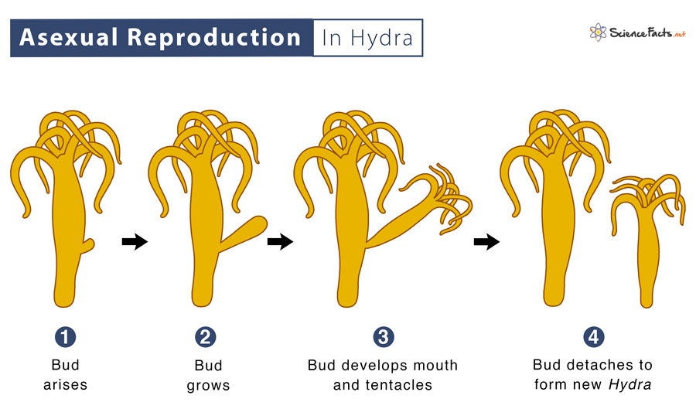
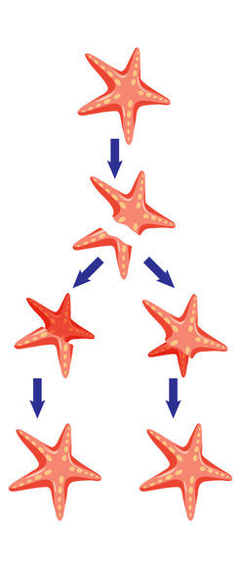
Asexual reproduction vs. Sexual reproduction
Asexual reproduction
  One parent produces offspring that is a clone
    Eggs are result of fusion between a haploid egg and haploid polar body
  Offspring is genetically identical to parent
  No genetic variation

Slide 3
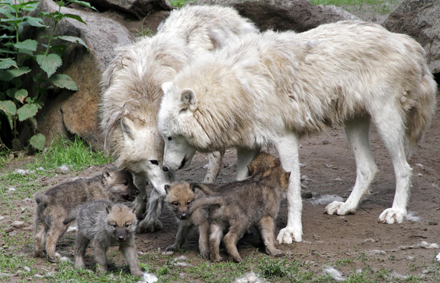
Asexual reproduction vs. Sexual reproduction
Sexual reproduction
  Two parents produce offspring
    via meiosis to make gametes (haploid)
  Offspring has genes from both parents
  Large amount of genetic variation

Slide 4
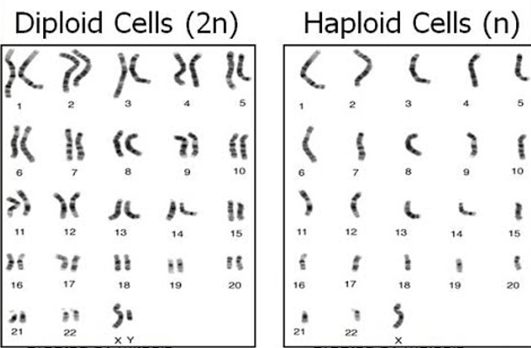
Haploid vs. Diploid
Diploid (2n): Cell has two copies of each chromosome
  Somatic cells are diploid
Haploid (n): Cell has only one copy of each chromosome
  Gametes are haploid

Slide 5
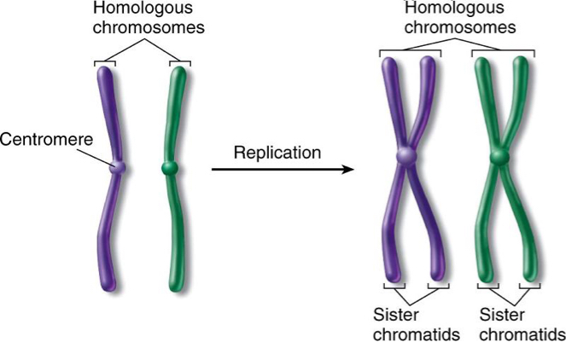
Homologous Chromosomes vs. Sister Chromatids

Slide 6
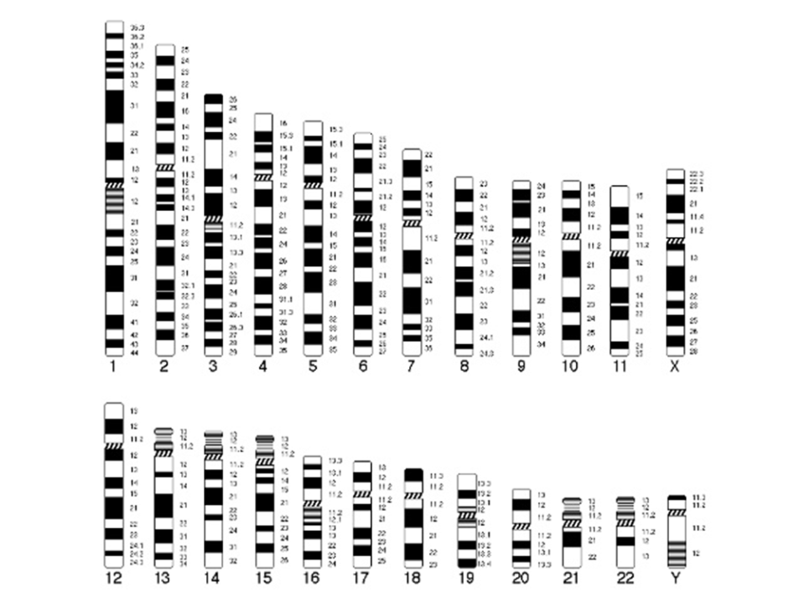
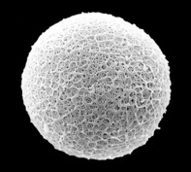
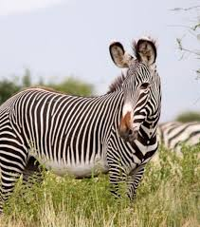
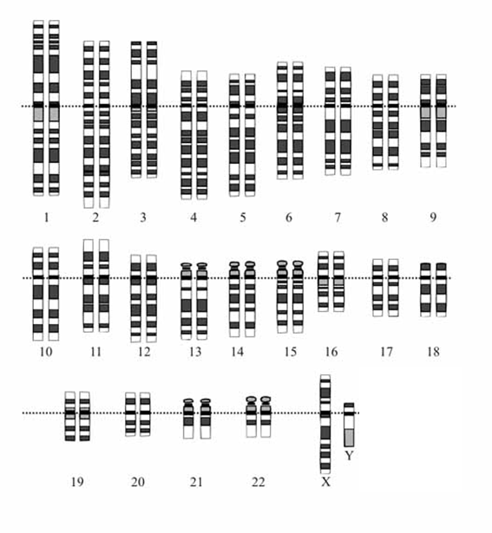

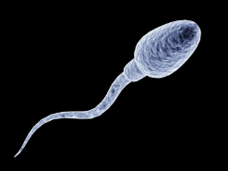
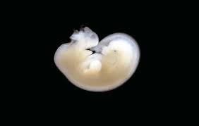
Haploid egg
Grevy’s Zebra gamete karyotypes & embryo karoypte
Diploid embryo
+
=
Haploid sperm

Slide 7
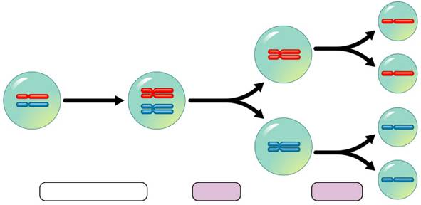
Meiosis
Cellular division that reduces chromosome number from diploid to haploid
Creates gametes (eggs and sperm)
Two stages:
  Meiosis I
    4 phases (Prophase I, Metaphase I, Anaphase I, Telophase/Cytokinesis I )
    Separates homologous chromosomes
    Produces 2 cells that are haploid (but still have sister chromatids)
  Meiosis II
    4 phases (Prophase II, Metaphase II, Anaphase II, Telophase/Cytokinesis II)
    Separates sister chromatids
    Produces 4 cells that are also haploid
      These are the gametes

Slide 8
Meiosis: two nuclear divisions
Meiosis I
Meiosis II
Interphase
  G₁
  S
  G₂
Prophase I
Metaphase I
Anaphase I
Telophase I/Cytokinesis I
No interphase after Telophase I/Cytokinesis I
  DNA is not replicated again
Prophase II
Metaphase II
Anaphase II
Telophase II/Cytokinesis II

Slide 9
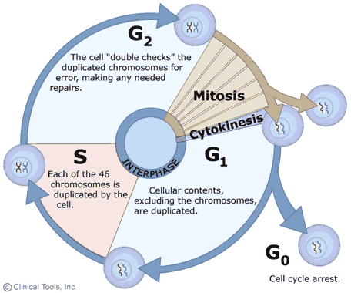
Interphase
Identical to Mitosis
Gap₁ phase (“first gap”)
  Growth and normal cell functions
S phase (“synthesis”)
  DNA is replicated
Gap₂ phase (“second gap”)
  Growth continues
  Cell prepares to divide

Slide 10
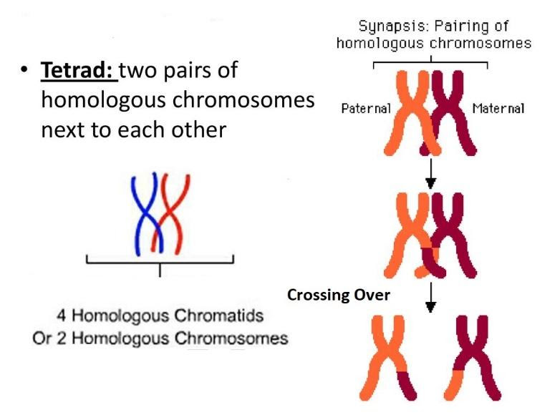
Homologous Chromosomes in Meiosis
In Prophase I of Meiosis I (after S phase), homologous chromosomes pair up to form tetrads
  Called synapsis
The tetrads bond with each other
  Non-sister chromatids from homologous chromosomes zipper together

Slide 11
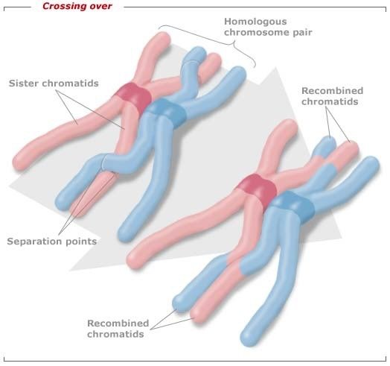
Homologous Chromosomes in Meiosis
Non-sister chromatids exchange genetic material with each other
  Called crossing over
  Physical location of crossing over is called chiasma (plural, chiasmata)
    Each pair of non-sister chromatids have at least one chiasma
  Produces recombinant chromosomes
    Chromosomes that carry genes from both parents

Slide 12
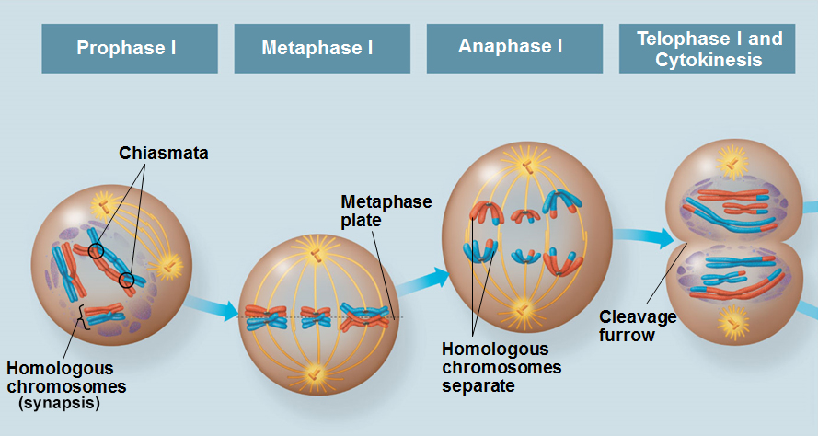
Meiosis I: Prophase I
Nuclear membrane begins to disintegrate
Chromosomes condense
  Each chromosome is comprised of two identical sister chromatids
Centrosomes move to poles of the cell
Mitotic spindle begins to form from centrosomes
Homologous chromosomes synapse into tetrads
  Crossing over occurs between non-sister chromatids
  of the tetrads
  Chiasma: location of crossing over

Slide 13
Meiosis I: Metaphase I
Homologous chromosomes align on the metaphase plate
  One chromosome of each pair facing a pole
Sister chromatids of one homolog are attached to the microtubule from one pole
Sister chromatids of the other homolog are attached to microtubule from the opposite pole
  Attached at kinetochores

Slide 14
Meiosis I: Anaphase I
Homologous chromosomes separate and move towards opposite poles of the cell
Sister chromatids remain intact and attached to each other

Slide 15
Meiosis I: Telophase I/Cytokinesis I
At beginning of this phase, each half of the cell has a haploid set of duplicated chromosomes
  Each chromosome is still composed of sister chromatids
Nuclear membrane forms around haploid sets of chromosomes
Cytokinesis occurs to separate cell into two daughter cells
  Daughter cells are haploid
    But still have chromosomes composed of sister chromatids
  Are not genetically identical to parent cell
  Are not genetically identical to each other

Slide 16
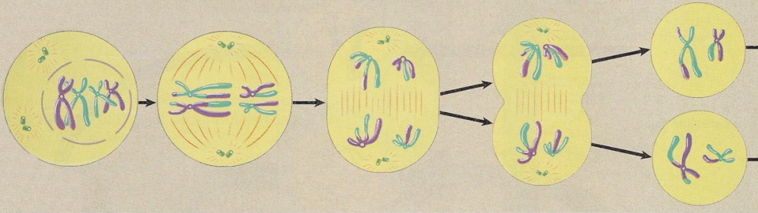
Meiosis I:

Slide 17
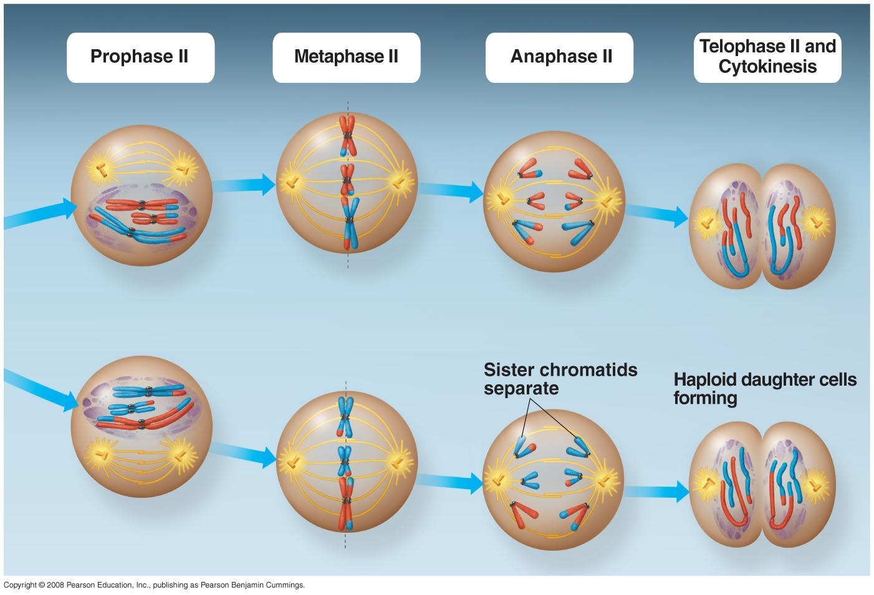
Meiosis II: Prophase II
There are two haploid daughter cells now
There is no interphase between Meiosis I and II
  DNA is not replicated again
Centrosomes once again move to poles of the cell
  Mitotic spindle begins to form from centrosomes again

Slide 18
Meiosis II: Metaphase II
Centrosomes are at opposite poles
Microtubules are attached to kinetochores of sister chromatids
Sister chromatids align on the metaphase plate

Slide 19
Meiosis II: Anaphase II
Cleavage of cohesion proteins holding sister chromatids together
Sister chromatids separate from each other
  Are now separate “daughter” chromosomes
Microtubules shorten
  Pull daughter chromosomes to opposite poles of the cell

Slide 20
Meiosis II: Telophase II/Cytokinesis II
Nuclei form around all four sets of daughter chromosomes
Chromosomes are become less condense
Microtubules depolymerize
Cytokinesis separates cells into four haploid daughter cells
  Daughter cells are genetically different from each other and from original parent cell

Slide 21
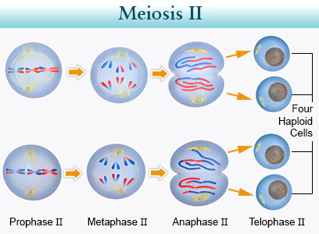
Meiosis II:
2 haploid daughter cells from Meiosis I
Metaphase II Anaphase II Telo/Cyto II Gametes

Slide 22
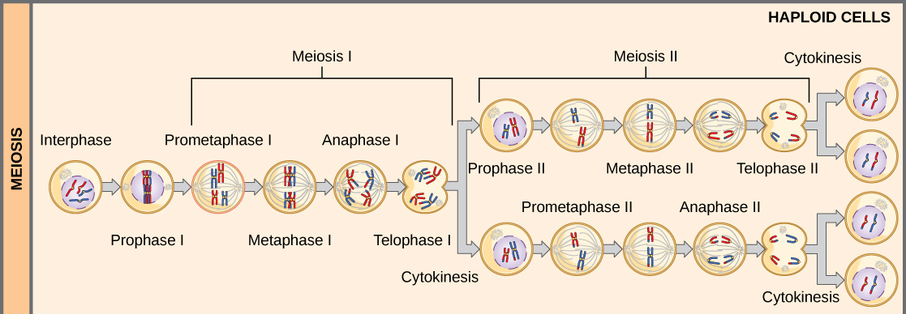
Meiosis from start to finish:

Slide 23
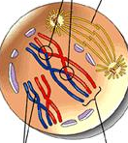
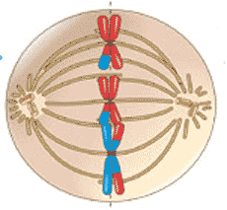
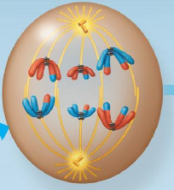
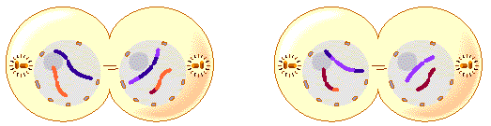
Which phase of Meiosis?
3
1
2
4

Slide 24
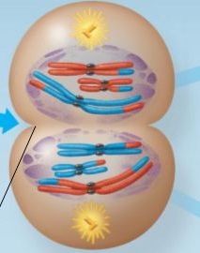
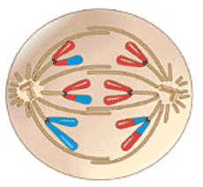
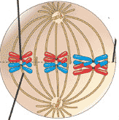
6
5
7

Slide 25
Meiosis and Sexual Life Cycles
Chapter 13
Part 2

Slide 26
Mitosis vs. Meiosis
Mitosis
Meiosis
Diploid parent cell produces two diploid daughter cells
  Daughter cells are genetically identical to the parent cell
Used for growth, repair, regeneration (and sometimes asexual reproduction)
Diploid parent cell produced four haploid daughter cells
  Daughter cells are genetically unique from parent cell and from each other
Used to produce gametes

Slide 27
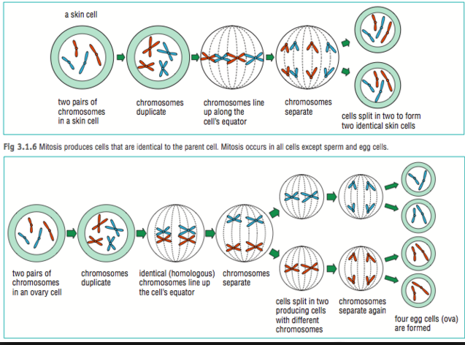
Mitosis vs. Meiosis
2 genetically identical diploid daughter cells
Mitosis
4 genetically distinct haploid daughter cells
Meiosis

Slide 28
Meiosis from start to finish:

Slide 29
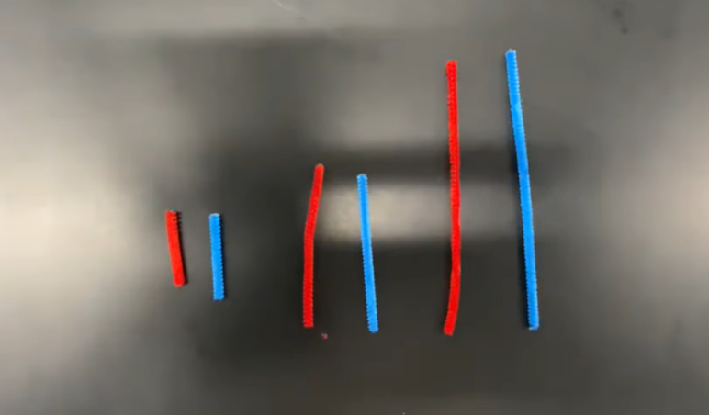
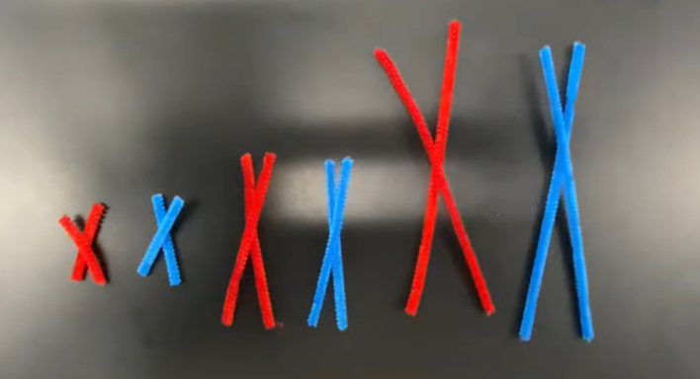
Mitosis: Interphase
Replication during S phase (note 12 chromatids, but sister chromatids so still 2n=6)
2n=6; 3 homologous pairs
Take a picture or write down what colors you start with:
Ex: blue-red, purple-brown

Slide 30
Mitosis: Prophase/Prometaphase
-nucleolus disappears (Prophase)
-nuclear envelope dissolves (Prometaphase)
-Mitotic spindle starts to form from centrosomes
-Centrosomes begin to move to poles
-Chromosomes condense = chromatids
- Microtubles attach to sister chromatids at kinetochores

Slide 31
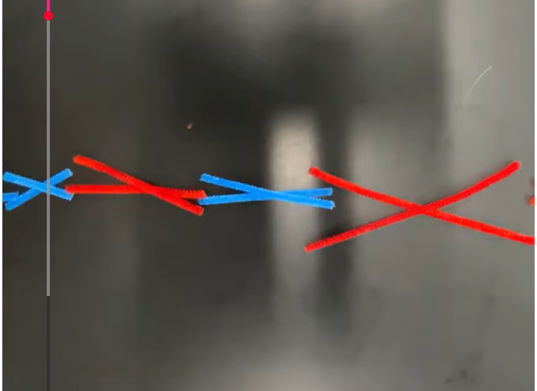
Mitosis: Metaphase
Sister chromatids line up on metaphase plate, but do not form tetrads like in Meiosis

Slide 32
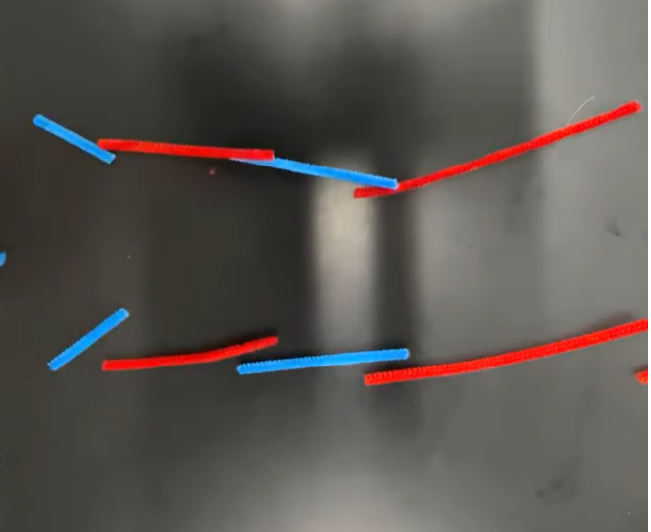
Mitosis: Anaphase

Slide 33
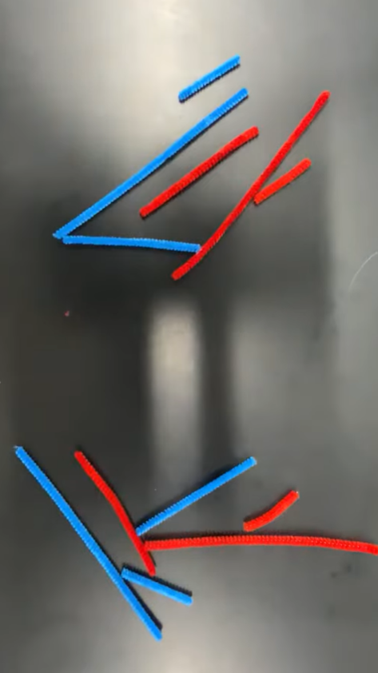
Mitosis: Telophase/Cytokinesis
2 identical daughter cells, 2n=6. Chromosomes from both mom and dad
Is this what you started with??

Slide 34
Meiosis: Interphase
Replication during S phase (note 12 chromatids, but sister chromatids so still 2n=6)
2n=6; 3 homologous pairs

Slide 35
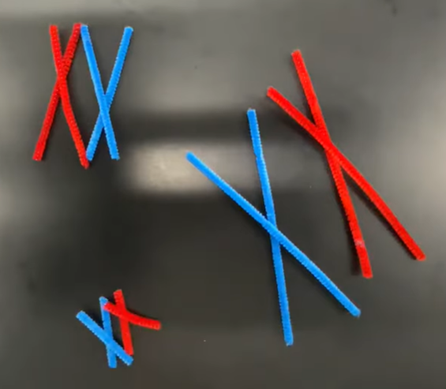
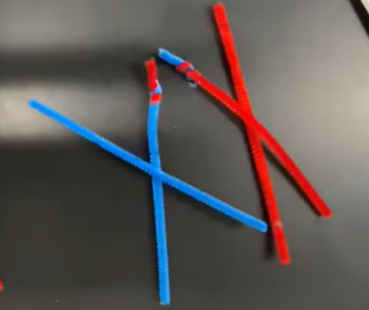
Meiosis: Prophase I
-nucleolus disappears (Prophase)
-nuclear envelope dissolves (Prometaphase)
-Mitotic spindle starts to form from centrosomes
-Centrosomes begin to move to poles
-Chromosomes condense = chromatids
Microtubles attach to sister chromatids at kinetochores
Synapsis occurs to form tetrads
  Crossing over = Recombinant DNA

Slide 36
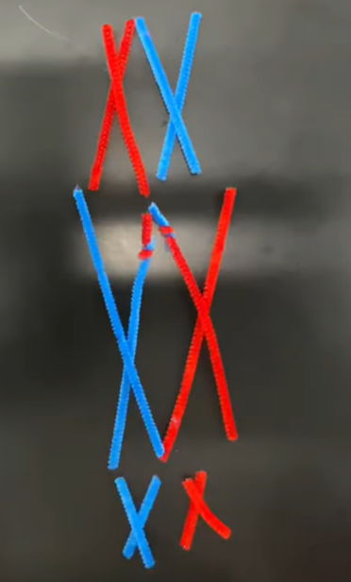
Meiosis: Metaphase I

Slide 37
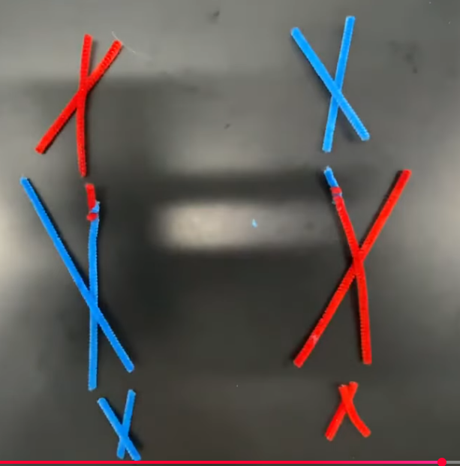
Meiosis: Anaphase I

Slide 38
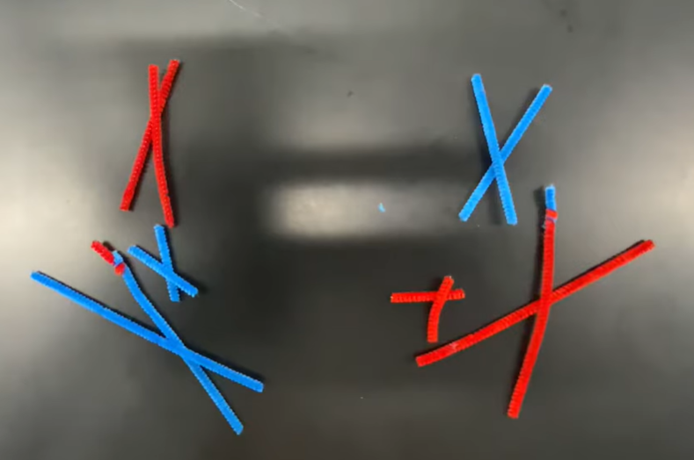
Meiosis: Telophase/Cytokinesis I
2 haploid daughter cells; 2n=3
Technically 6 chromatids, but 3 pairs of sister chromatids
Are these what you started with??

Slide 39
Meiosis: Prophase II
Do NOT have a second interphase between the stages of Meiosis

Slide 40
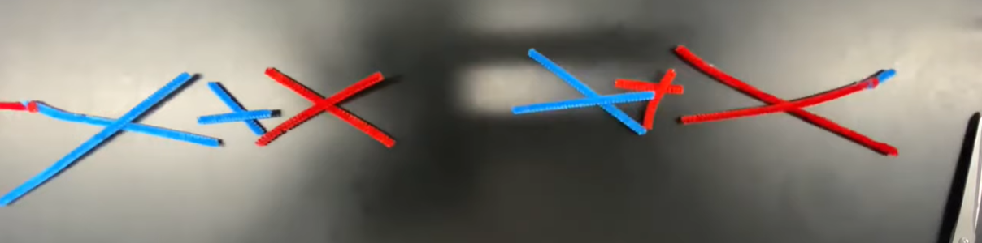
Meiosis: Metaphase II

Slide 41
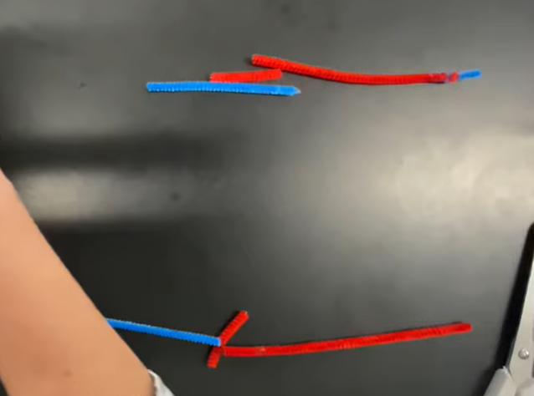
Meiosis: Anaphase II

Slide 42
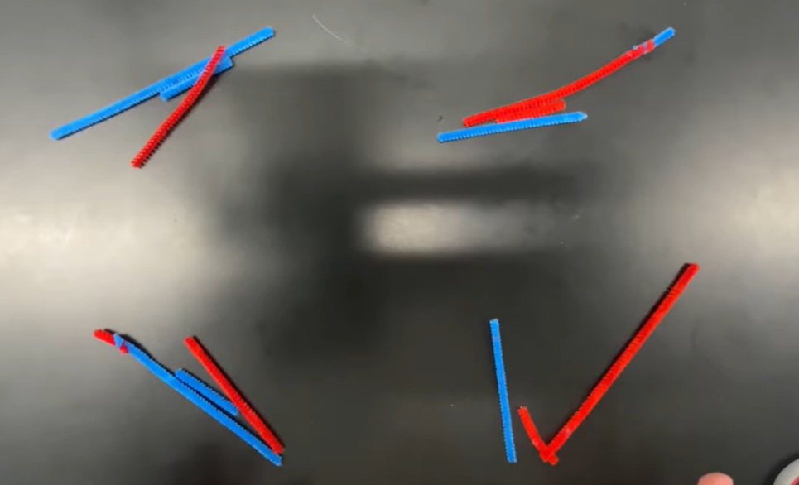
Meiosis: Telophase/Cytokinesis II
4 haploid daughter cells (sex cells)
Not identical to each other and not identical to the parent cell

Slide 43
If 2n = 10
  How many chromosomes?
  How many homologous pairs?
  How many chromatids present in Prophase I? Sister chromatids?
  How many tetrads are present?
  Which structures align along the metaphase plate in Metaphase I?
  How many sister chromatids present in each cell in Prophase II?
  How many chromosomes are present in each cell at the end of Meiosis II?

Slide 44
In which meiotic phase are sister chromatids separated?
In which meiotic phase do homologous chromosomes synapse into tetrads?
At which meiotic phase are the cells first considered to be haploid?
Are the chromosomes duplicated again before Prophase II?

Slide 45
Meiosis and Genetic Variation
Why don’t all siblings look alike?
How do species evolve?
The answer to both questions is the same: Genetic Variation!
Meiosis and sexual reproduction provide three opportunities for genetic variation:
  Crossing over
  Independent Assortment of chromosomes
  Random fertilization
Mutation provides a fourth type of genetic variation

Slide 46
Genetic Variation
Crossing over during Prophase I
  Produces recombinant chromosomes
    Genetic material from both parents on same chromosome
The Law of Independent Assortment of Chromosomes
  Random orientation of homologous chromosomes along the metaphase plate during Metaphase I of Meiosis
  There are 2^{n} possible combinations of daughter cells after Meiosis I, where n = haploid number
    Humans have 2²³ (8.4 million) possible daughter cells!!
Random fertilization
  Random sperm fertilizes random egg
  2²³ x 2²³ = 70 trillion possible combinations

Slide 47
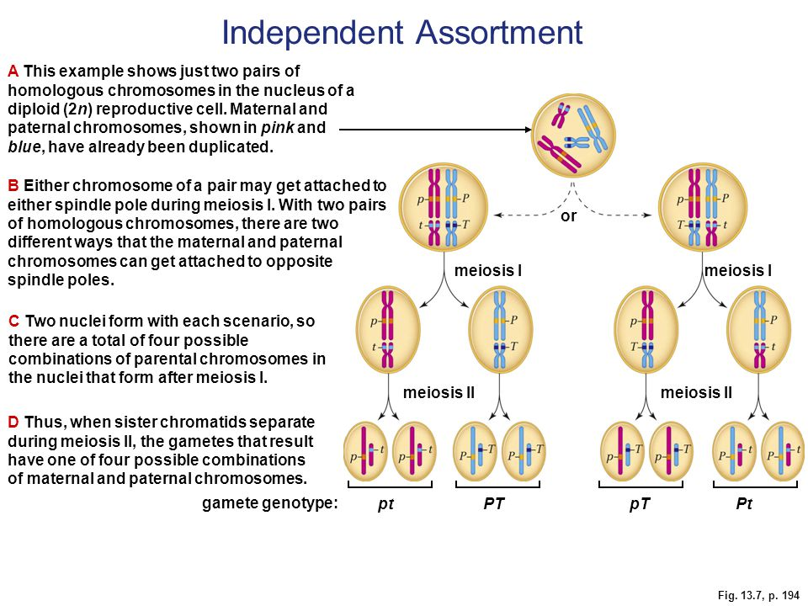
Law of Independent Assortment
During Metaphase I, each tetrad’s orientation is independent of all other tetrads when they line up on the metaphase plate
This means that variations of genes (alleles) for a specific trait segregate independently

Slide 48
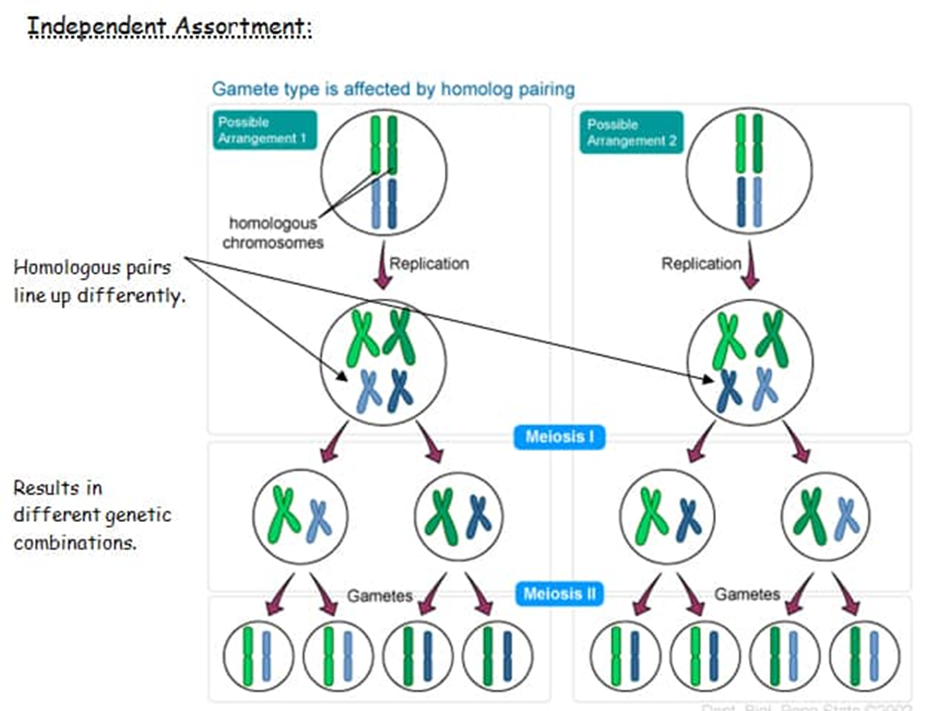
A closer look at Independent Assortment

Slide 49
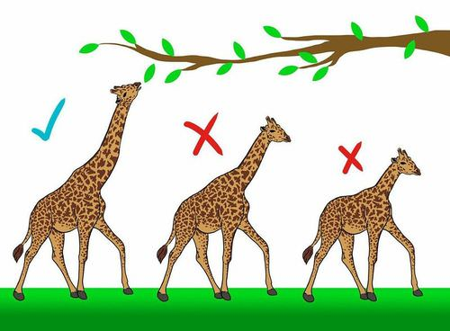
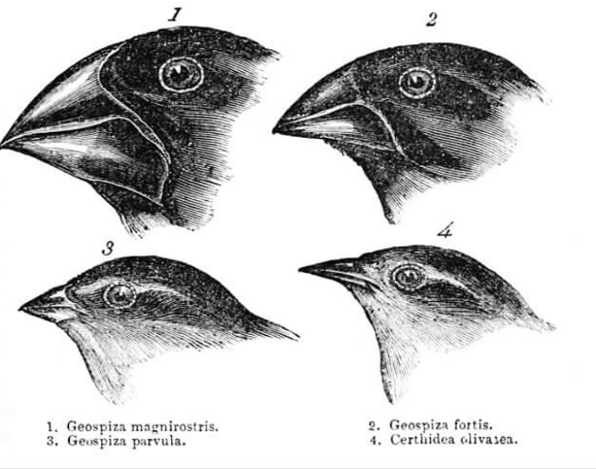
Evolutionary significance of genetic variation
Populations evolve through differential reproductive success of individuals
Individuals best suited (genetically) to their environment leave more offspring than individuals less suited to their environment
Natural selection accumulates genetic variation most adapted to the environment

Slide 50
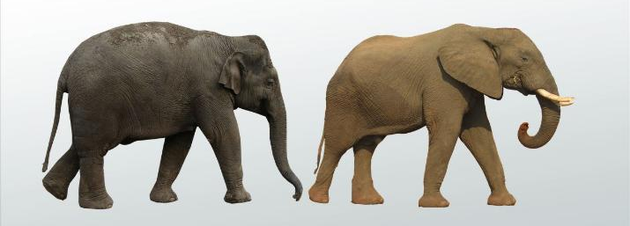
Evolutionary significance of genetic variation
As environment changes, the population will survive if at least some members have genes that allow success.
Mutations are the original source of different alleles
  These new alleles are mixed and matched during meiosis
  This shuffling of alleles provides potential for some combinations that work better in the newly changed environment
Sexual reproduction is favored in an unstable environment

Slide 51
Abnormal chromosome numbers
Normal Meiosis
  Anaphase I: homologous chromosomes separate
  Anaphase II: sister chromatids separate
  Telophase II/Cytokinesis II: separated sister chromatids (daughter chromosomes) result in 4 daughter cells.

Slide 52
Abnormal chromosome numbers
Nondisjunction is an error in which homologous chromosomes and/or sister chromatids are not properly separated
  Gametes contain an extra chromosome or are lacking a chromosome
  Fertilization with these gametes results in an individual with extra or missing chromosomes
    This is called aneuploidy
    Having only one chromosome of a homologous pair is called monoploidy
    Having three (or more) chromosomes of a homologous pair is called polyploidy

Slide 53
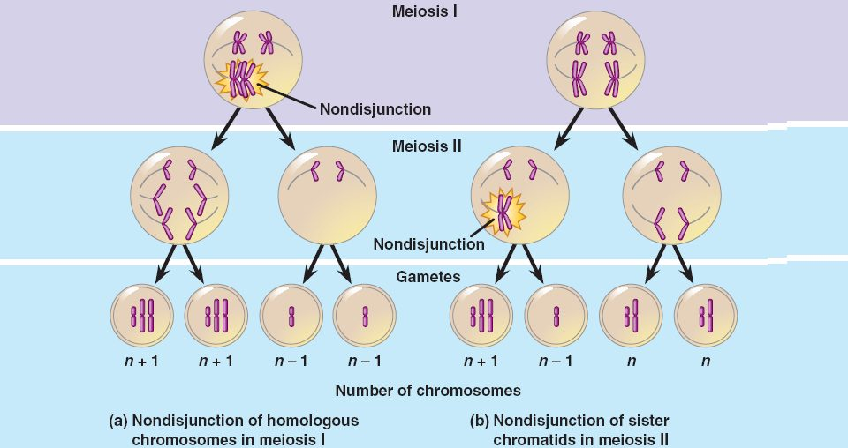
Nondisjunction

Slide 54
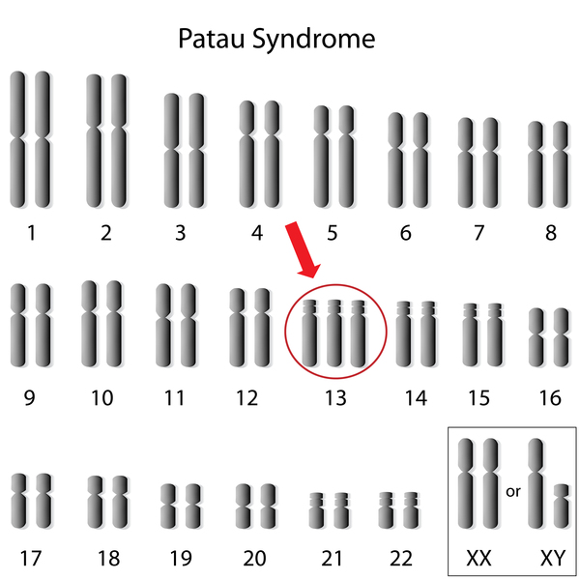
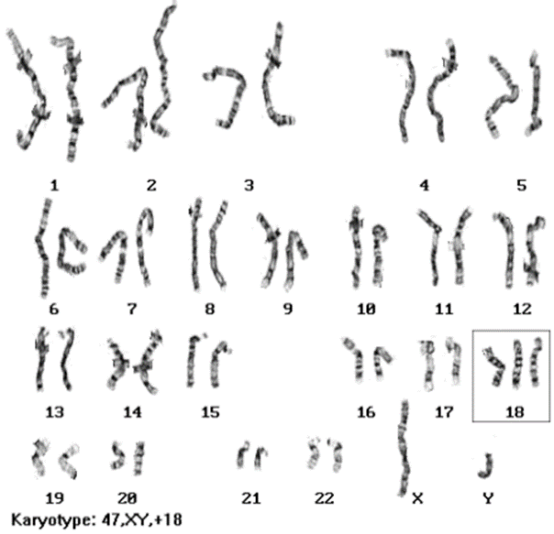

Genetic disorders caused by nondisjunction
Autosome disorders
  Trisomy 13 – Patau Syndrome – 3 copies of chromosome 13
    Serious brain/organ defects
  Trisomy 18 – Edwards Syndrome – 3 copies of chromosome 18
    Serious organ/joint defects
  Trisomy 21 – Down Syndrome – 3 copies of chromosome 21
    Developmental delay
      Sometimes mild, sometimes severe
    Heart defects
    Life expectancy is approximately 60 years
      The most survivable of all trisomy conditions

Slide 55
Genetic disorders caused by nondisjunction
Sex chromosome disorder
Involve X and/or Y chromosomes
  Trisomies:
    XXX (Triple X Syndrome; females)
    XXY (Klinefelter Syndrome; males)
    XYY (Jacobs Syndrome, males)
  Monosomy:
    X0
      Only known survivable monosomy

Slide 56

Genetic disorders caused by nondisjunction
X0 monosomy – Turner Syndrome
  Individuals are female, but with only one X chromosomes
  Conditions vary among females, most common is sterility
  Only known survivable human monosomy

Slide 57

Alterations in Chromosome Structure
Errors in Meiosis
  Breakage of chromosomes
  Cause genetic disorders, birth defects, or infertility
  Can be balanced (no genetic material lost) or unbalanced (genetic material gained or lost)
One main type with three possible outcomes:
  Deletion error – part of the chromosome is broken off

Slide 58



Alterations in Chromosome Structure
Duplication error
  The deleted part of the chromosome attaches to its sister chromatid
  Can also attach to nonsister chromatid of homologous chromosome
Inversion error
  Deleted part reattaches to same chromosome but inverted
Translocation error
  Deleted part reattaches to nonhomologous chromosome

